Slide 1

Norwich University
Blackbaud NetCommunity Grow Training
Melody Mulkey
Senior Consultant
503.575.0222 ● melody.mulkey@blackbaud.com
Notes:
TITLE SLIDE.

Slide 2

Team Introductions
Senior Consultant – Melody Mulkey
  BBNC Functional Resource
  Conducts functional configuration and training sessions
Norwich Team Members

Slide 3
Navigating in netCommunity
There are a couple ways to access your BBNC pages.
https://alumni.norwich.edu/ – This link will take you to the home landing page designated in the BBNC database. This is usually the Login Page.
https://alumni.norwich.edu/login.aspx - If you do not want to use the BBNC Login Page, this link will take you directly to a login page for Administrators.
https://alumni.norwich.edu/testconfig.aspx - This link is used for troubleshooting errors on your site. It will show your database version, add-ons and details on what is working and what is not. The status should read OK on all areas if functioning normally.

Slide 4
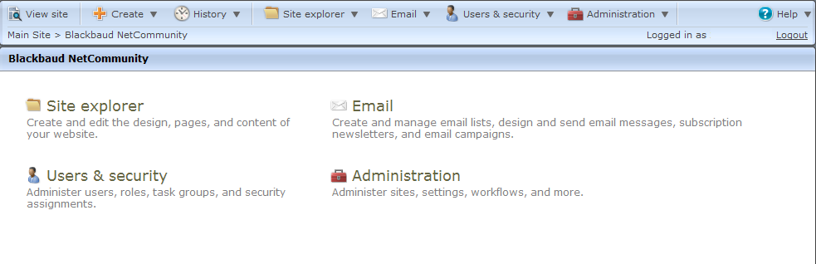
Navigating in netCommunity
Logins with proper permissions can access the Administrative navigation bar. These menus will allow users to add, modify and delete in NetCommunity as well as manage system settings and users.
Notes:
Go over the various buttons on the admin navigation bar. View the page / edit page. Show few ways to get to pages and parts.
Site explorer / go through the templates
Pages and templates – folders, searches
Look at the Style Guide – must match the current design
Show how to delete pages, where it goes, and then how to restore them (Deleted Pages are not searchable) Only empty folders may be deleted.
Go over the Parts section – how to view and edit
Talk about Approvals – how this work
Files – how to add, search, use it to link to other images or pages, etc
Forms – does not link to RE but can be exported and saved in BBNC
Show them also “Help” and what is housed there
Will most likely talk to them about Help and resources later on – subscribe to blog

Slide 5
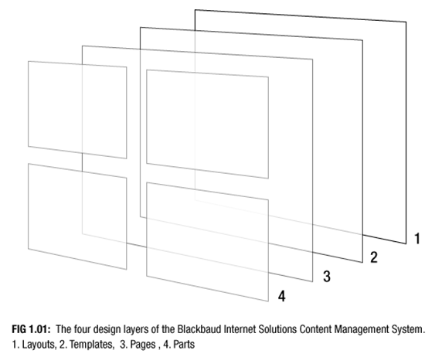
NetCommunity Grow structure

Slide 6
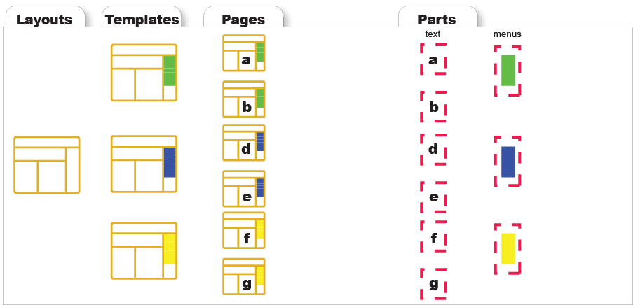
Review

Slide 7
Editing Your Site –
  Creating a new Page
    Login as an administrator.
    Select “Create” in the administrative navigation at the top of the page.
    Create a new page, setting up name, selecting folder and template.
  Creating a new Formatted Text and Image Part
    From the newly created page, click in the content area where you want the part to be and select “New Part”.
    Select a “Formatted Text and Image” Part.
    Fill in the name and click next.
    Using the Editor, add text to the open content area on the page.
  Adding images
    Put your cursor where you would like the image to be on the page and click on the tree icon to access the Image Library and select your image.
    Once the image is on the page, double click on it to get the Image Editor Screen.
    On the second tab you can modify the placement of the image and wrapping of text around it.
  Adding hyperlinks and menu links
    Select the item you want to create a link with, either an image or text.
    Click on the chain link in the Editor and browse out to the page you want to link to.

Slide 8
Editing Your Site (continued)
  Linking a page to a menu
    Go to edit the page.
    Either select the “Template Designer” button at the top of the page or click on the menu part itself and select “Edit Page Template”.
    Once on the template level (you will see no content on the page), click on the menu part and select Edit.
    Inside the menu part there will be a list of menu labels.
    To add a new label, click on the orange “+” in the upper right.
    To create the link for the label, click on the binoculars and browse out to the page you want to link to.
    The purple arrows in the upper left allow you to move the menu label up or down in the order or indent to make it a submenu.
    When complete, click on save.

Slide 9
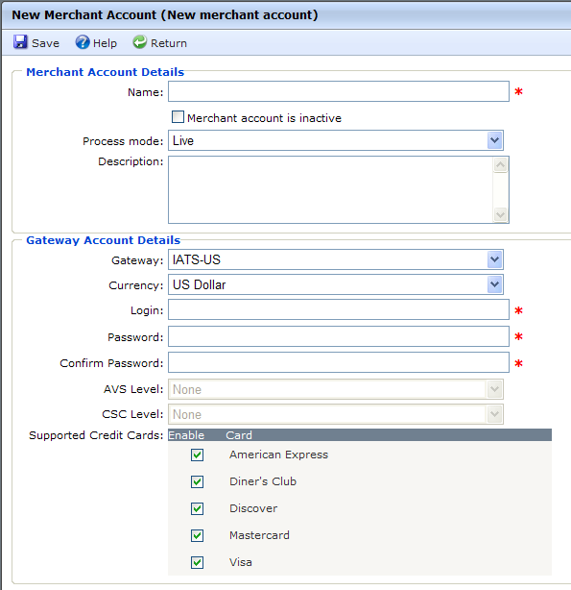
Administration – Merchant Accounts
NetCommunity Merchant Accounts, allow you add merchant account information to process payments through parts and forms in your Grow database. Each form in Grow that processes credit card transactions links to a merchant account stored here.
NOTE: For testing purposes, there is a Demo Merchant Account setup. This must be switched to a live Merchant Account prior to launching your forms.

Slide 10
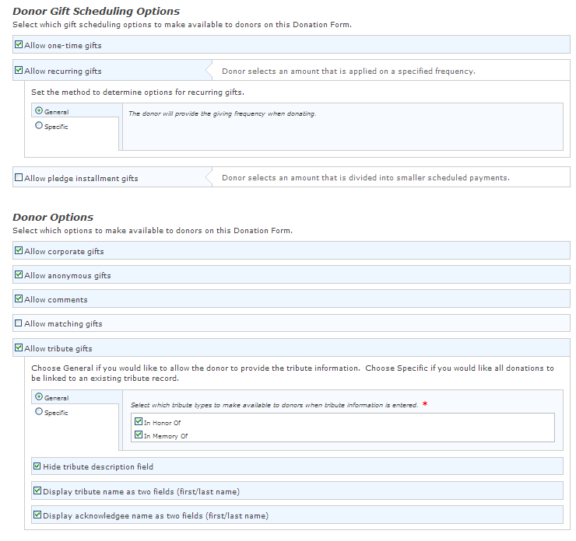
Donation Form
The Donation Form allows users to apply configuration settings to gather required information.
Options include pledges, tribute gifts, and recurring gifts.
The Donation Form links to one or multiple funds in Raiser’s Edge that the donor can choose as the designation for their gift.

Slide 11
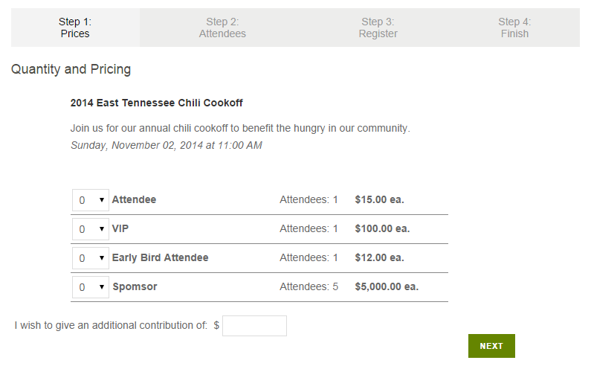
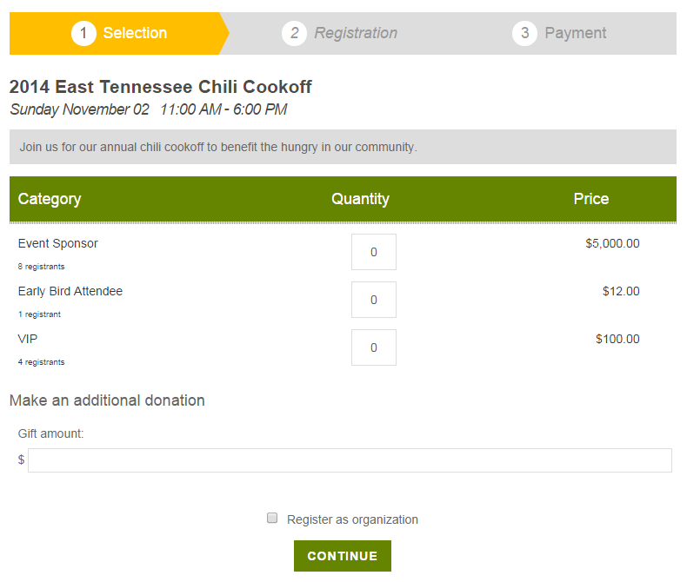
Event Registration forms
NetCommunity has two Event Registration Forms. The original form is referred to as “Classic” and has been around since the original release of the software. The latest release sometimes called “New” or “2.0” came out in late 2013. It incorporates recommendations from clients over the years.
Classic Form
New Form

Slide 12
Event Registration forms
Both forms are available to use. In deciding which is best for your event, the table below compares the two forms and what they can do best.
Functionality | Classic | New
Works with Single or Multiple Events | ü | ü
Allows additional donations with registrations | ü | ü
Can use with Participant Attributes | ü | ü
Accepts Organization registrations |  | ü
Can be used with "Shopping Cart" | ü
Includes "Language" tab to change text on form |  | ü
Allows customization for free events to hide pricing related information and unnecessary fields. |  | ü

Slide 13
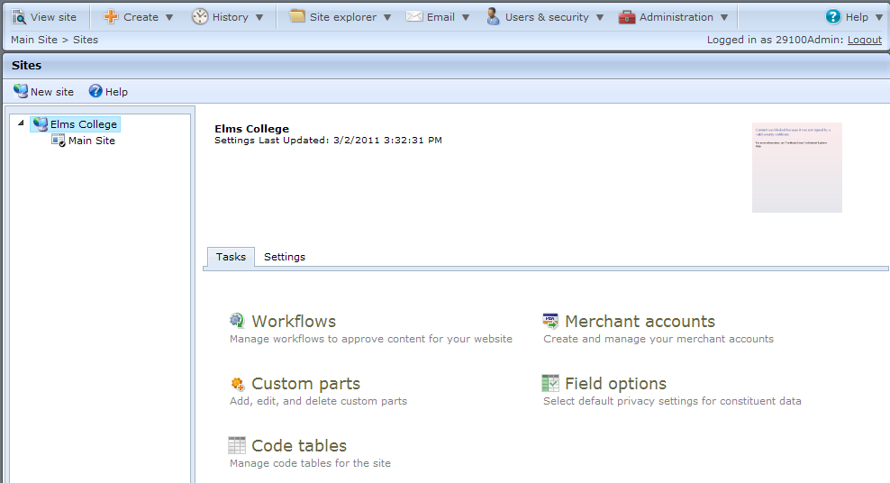
Administration – System Options
NetCommunity Site Settings include Supported Languages, International Settings, Pages, Registration/Login Options, Email Opt-in, User Image Options, Site Tracking, and reCAPTCHA.
When you host one website, site settings only apply to your default site. When you host multiple websites, you apply site settings to each default, parent, and child site.

Slide 14
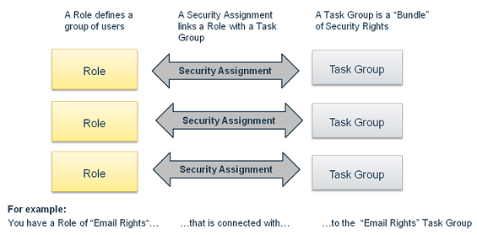
Administration - Security
NetCommunity Security allows you to create a structure that is as simple or complex as needed. Security components include users, roles, task groups, and security assignments. These components answer the security questions of who, what, and where.
Roles are user records grouped together manually or by query. Roles can also include other roles.
Task Groups organize rights to associate with a role in Security assignments

Slide 15
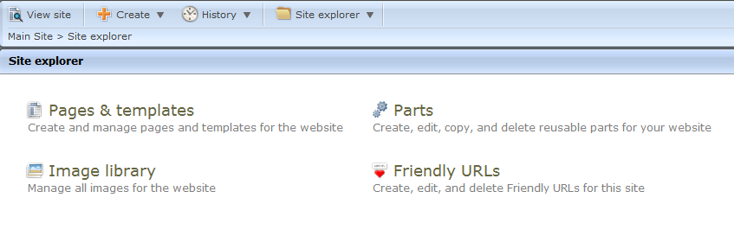
Administration - Security
Task Group Permissions
1. Standard Content Rights Task Group |  | Full Rights | Create Rights | View Rights
Website Security | Page Tasks | X
 | Part Tasks | X
 | Image Tasks | X
 | Template Tasks |  | X | X
 | Layout Tasks
Menus available for Task Group

Slide 16
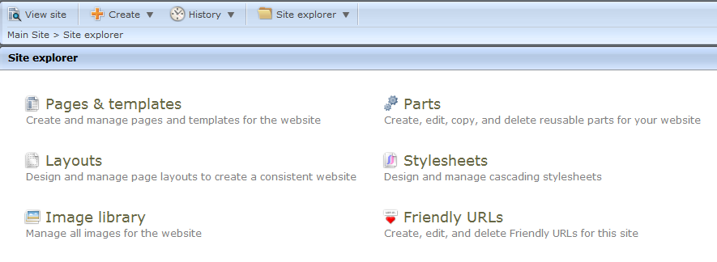
Administration - Security
Task Group Permissions
2. Advanced Content Rights Task Group |  | Full Rights | Create Rights | View Rights
Website Security | Page Tasks | X
 | Part Tasks | X
 | Image Tasks | X
 | Template Tasks | X
 | Layout Tasks | X
Menus available for Task Group

Slide 17
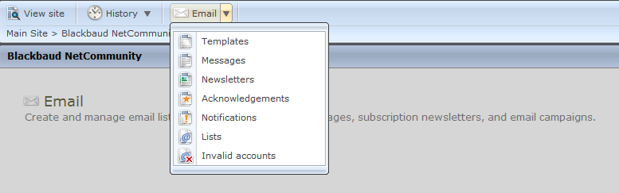
Administration - Security
Task Group Permissions
3. Email Rights Task Group |  | Full Rights | Create Rights | View Rights
Email Rights | Email Template Tasks | X
 | Email Tasks | X
 | List Tasks | X
 | Campaign Tasks | X
 | eCard Tasks | X
 | Scheduled Email Tasks | X
Admin and Security Rights | Approval and Workflow
 | Organization Settings
 | Site Level Tasks
Menus available for Task Group

Slide 18
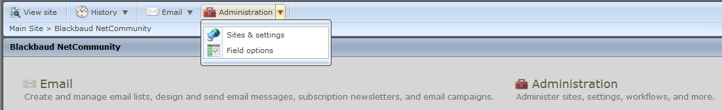
Administration - Security
Task Group Permissions
4. Administrative Rights Task Group |  | Full Rights | Create Rights | View Rights
Email Rights | Email Template Tasks
 | Email Tasks
 | List Tasks
 | Campaign Tasks
 | eCard Tasks
 | Scheduled Email Tasks
Admin and Security Rights | Approval and Workflow | X
 | Organization Settings | X
 | Site Level Tasks | X
Menus available for Task Group

Slide 19
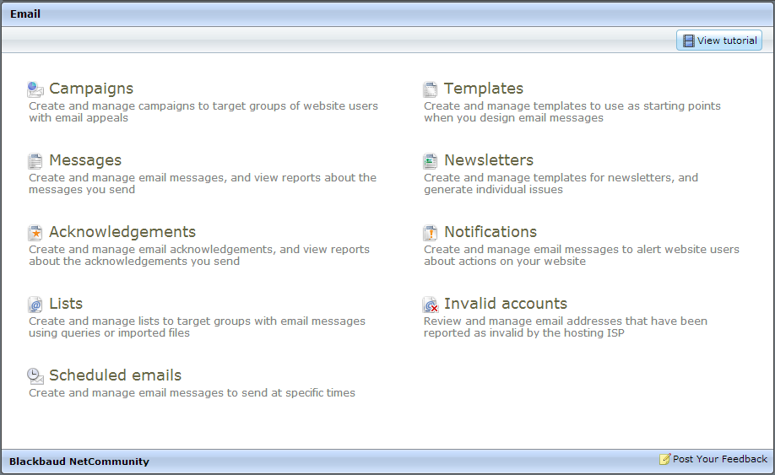
Emails
The NetCommunity Email features offer several tools for sending messages and reporting on them. The focus of our Grow session will be on the use of Templates, Lists and Messages.

Slide 20
Email processing workflow
Email Purpose & Details are finalized
Template is determined
Target audience is identified
List is requested or prepared
Email Message is drafted
Email Message is tested
Email Message is sent
Email Message is tracked
Email Report is generated
Email Admin or maintenance

Slide 21
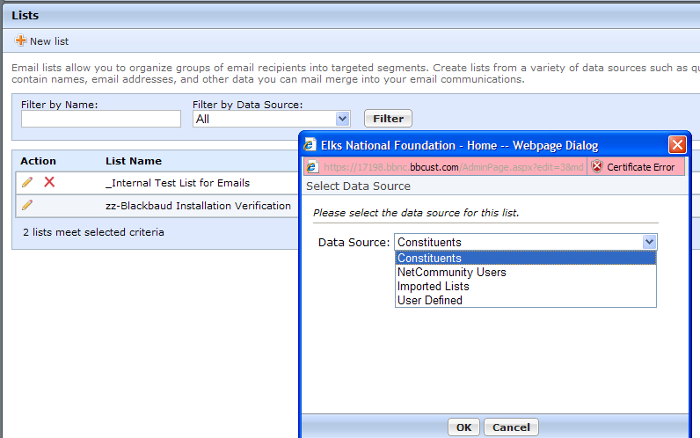
Email Lists
Grow email lists can pull from four types of data sources: Constituents, NetCommunity Users, Imported Lists, and User Defined.
Constituent Lists – Lists based on dynamic queries in RE. Benefits: allows the user to bring Bio data into merge fields and reporting on open rates and click-throughs feed back to constituent record.
Imported Lists – Email lists can also be
imported in a .csv file with just an email
address and name. Benefits: If additional fields
are imported they can be used in the
email merge fields. Drawback: does not send
reporting data back to the constituent record.
NetCommunity Users – This list pulls
from anyone that has registered in
NetCommunity based on the dynamic
query in RE linked to the User Role.
User Defined – Individual names and
emails can be manually added to Grow
to create a list. This is typically used for
testing or individual emails.

Slide 22
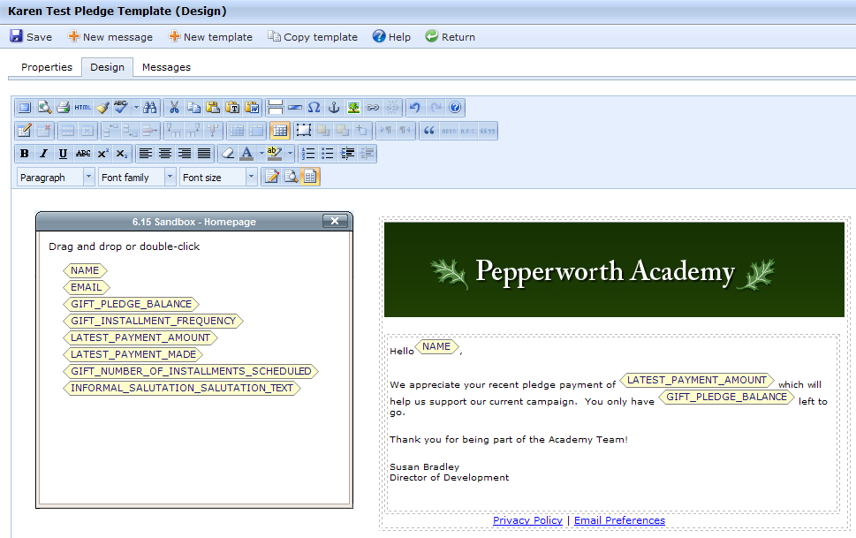
Email Merge Fields
Merge fields available are based on the data source designated in the template.
Constituent data sources will show merge fields from Bio, Preferred Address, Phone, Email, Spouse, Alumni, and Attributes.
If other merge fields are required they need to be imported into a list from a .csv file.

Slide 23
De-duping of emails
Does Blackbaud NetCommunity automatically prevent the sending of duplicate emails?
  Constituent Lists from RE
  The constituent lists will be de-duplicated on a per-message basis, if the message is sent to multiple lists and the same record appears in more than one list. This means a record can exist in multiple lists and only receive one copy of the email.
  Imported Lists from Spreadsheet
  For Imported Lists, de-duplicating will automatically occur. If the list contains the same email address more than once, the message will only be sent to that email address once.
  Combining Constituent List and Imported List in one Message
  Please note that a message utilizing lists based both on Imported Lists and Constituent Queries may duplicate, as there is no check made between the two types of lists.

Slide 24
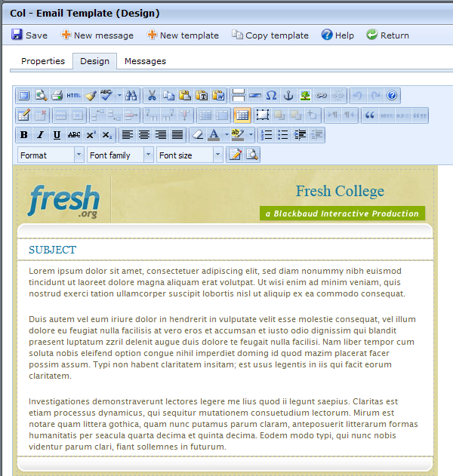
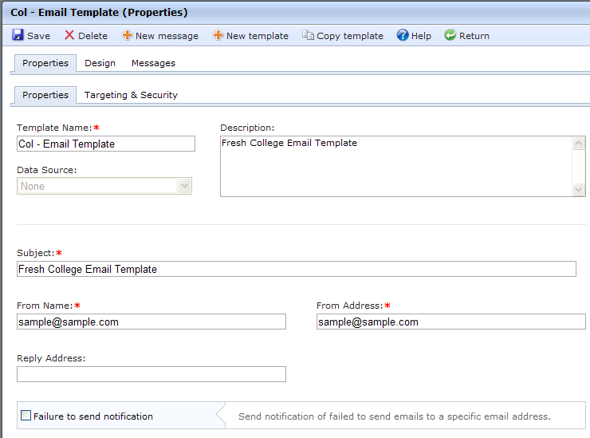
Email Templates
Email templates contain information that will be used more than once such as the From Name, From Address, Reply Address. Templates also contain the design including header, footer and logo.

Slide 25
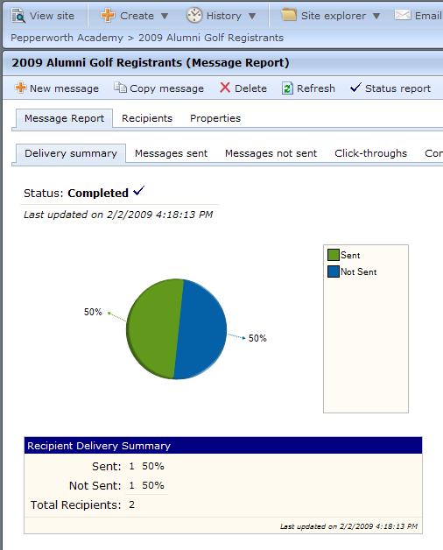
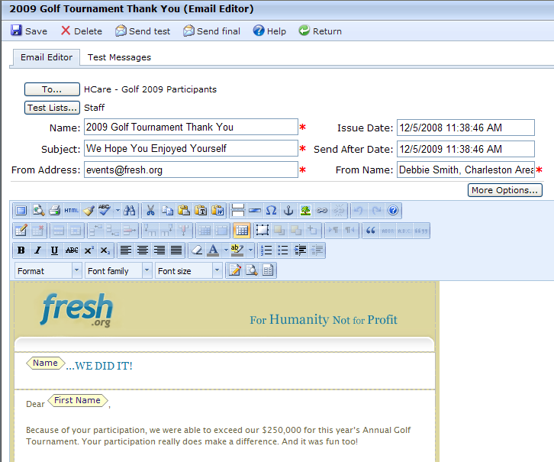
Email Messages
Messages are created using a Template and adding text, then sending it to a saved
User List. Grow also provides reporting on the message level including sent, not sent, click-throughs and conversions.

Slide 26
Email Reporting
The Sent tab displays how many emails were opened, not opened, and not delivered.
  “Opened” indicates the recipient displayed the email’s images or clicked a link in the email.*
  “Not opened” indicates the email was delivered but the recipient did not display its images or click a link.
The Click-throughs tab displays all web pages that the email links to, along with how many times recipients click the links and how many unique recipients click the links.
For example, if you include a link to an events page, it appears in the grid on the Click-throughs tab. If a recipient clicks that link three times, the Total views column for the events page increases by three and the Unique viewers column increases by one. To track click-throughs, the program associates email IDs with email messages.
When you include a link in an email message, the program appends a destination link value that includes the email ID to the site URL that you specify in Sites & settings. When an email recipient clicks the link, the program redirects the user to the page through the site and then associates any resulting activity with the email ID.
Reporting will be brought into RE Constituent records for emails sent using a Constituent Email List, even if they are not a NetCommunity Member. If you are using an imported list, the email reporting will not feed back into RE even if they are a constituent.
* Note: When sending emails from NetCommunity, a transparent image is added to the end of the email that allows the software to determine if the email has been opened or not. If an external DNS record has not been created that matches the Site URL configured in NetCommunity, the user's email editor will not be able to download this image, which in turn will not allow NetCommunity to track whether the message has been opened or not.

Slide 27
Email Bounces
“Not delivered” indicates the email "bounced," or could not be delivered. Email delivery may fail for multiple reasons, such as a temporary network issue, a full mailbox, a content filter, or an invalid account.
A “bounced” email is one that is sent but cannot be delivered. The email Message Report includes details about two types of bounces: hard and soft.
  A hard bounce occurs when you send the message to an invalid account.
  A soft bounce occurs if the message reaches the recipient’s mail server but cannot be delivered. This may happen, for example, if the recipient’s mailbox is full or the size of the message is too large. You can view a breakdown of how many messages bounced and the type of bounce that occurred.
How the program handles a bounced email depends on the type of delivery failure.
  If the bounce error is caused by a temporary failure such as a network error, full mailbox, or content filter, the program tries to send the email again periodically for up to 24 hours. For a message or newsletter, you can view the latest bounce information on the Recipients tab on the Message Report or Issue Report screen. For an acknowledgement, you can view the latest bounce information on the Messages tab on the Acknowledgement Report screen. Note: If an email bounces due to a temporary failure, you can click Click here to resend in the Action column to attempt to send the email again.
  If the bounce error is caused by a permanent failure, such as an unknown user or address, the account is marked invalid. You can also view bounce information about these accounts in Invalid accounts. For information about how to manage your invalid accounts, see Invalid Accounts. Note: To prevent your email address from being blacklisted, the program does not send email to an account that is marked invalid.

Slide 28
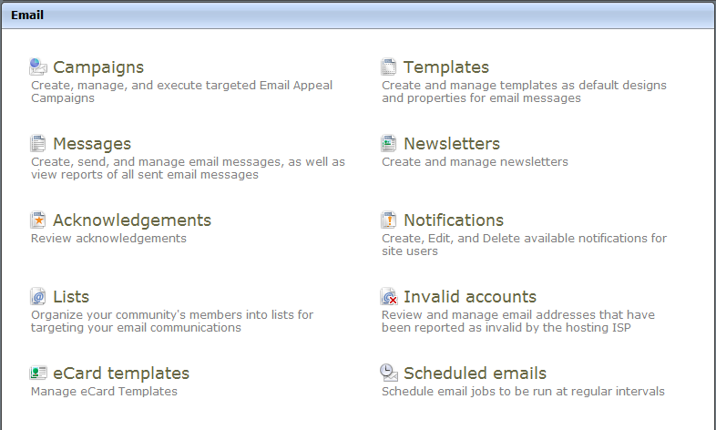
Email Messages or Newsletter functionality
Email Message functionality in uses Lists to specify who will receive your communication.
Newsletter functionality is a subscription service. It maintains an internal record of anyone that has subscribed to the newsletter through NetCommunity.
It will only send the newsletter to subscribers and there is no option to attach a list.
Due to this restriction in the Newsletter part, it is recommended to send all communications, including Newsletters, with Message functionality to be able to target specific constituents.

Slide 29
Maintaining Email Message Preferences
The User Email Preferences form allows users to unsubscribe from ALL email communication to keep us compliant with anti-Spam regulations.
From a best practice point of view, it is recommended to also offer them a choice of specific communications so you don’t cut off contact with them entirely. This can be done by creating Constituent Attributes for each communication you send. When you set up the Attribute, it can either be a “Yes/No” type or linked to a table.
The “Yes/No” type will show up with a drop down list where the user can choose either option. If you use a table instead, it will display as a list of your communications where the constituent can make a choice by checking a box.
Below is an example of how to set these up in RE. If you are using the Yes/No type, you will need to check “Allow Only 1 Per Record” and it will show up in a drop down list. If you are doing a Table instead, you do not need to check the “Allow Only 1 Per Record”.

Slide 30
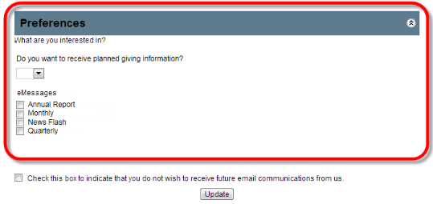
Email Message Subscription Preferences (continued)
After creating the Attributes you can return to NetCommunity. Go to the Code Tables section under Administration and click on the “Refresh Code Tables” in the upper left corner.
Next go to the Sites and Settings, also under Administration and scroll down to the Constituent Attributes. Check the boxes next to the new attributes to turn them on so they will be available on your forms.
In the User Email Preferences form, turn on each attribute by checking the box to include it and create a user friendly caption.
On the front of the form, it will show either as a drop down list or checkboxes as shown to the right. The option for a global opt out will be at the bottom.
Note: To use constituent attributes as email preferences, you must include your website users' constituent attributes on their corresponding constituent records in RE. For existing constituents, we recommend that you globally add the attribute for each communication type to the constituents record. This way, when these constituents access the email preferences page in Blackbaud NetCommunity, they are subscribed to the appropriate emails.

Slide 31
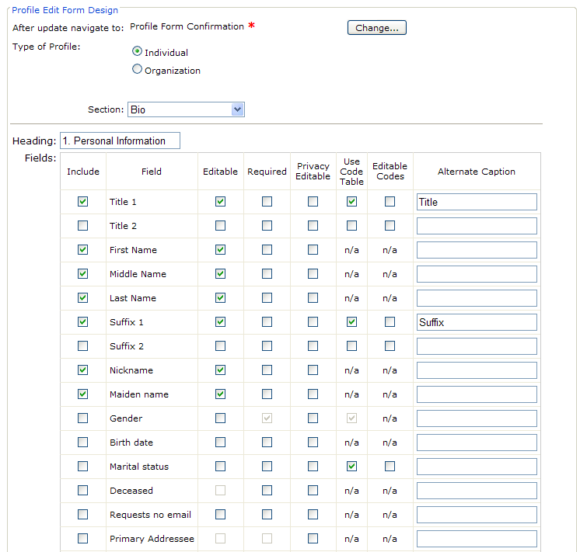
Profile Update Form
The Profile Update Form allows the user to provide additional biographical information beyond what is included in the initial registration form.
There are six tables of information to choose from including:
  Biographical
  Preferred Address
  Business
  Phones and Email
  Spouse
  Primary Alumni
In these tables, you can select the fields to include on the form as well as what information should be private or editable.

Slide 32
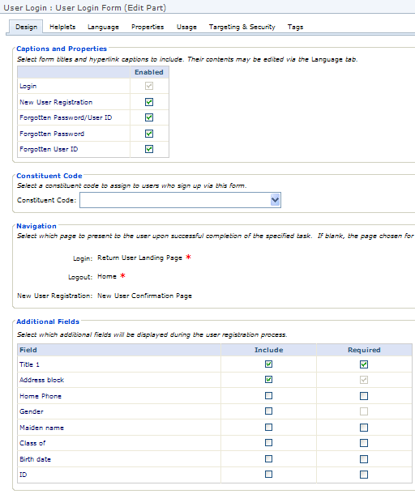
Login Form
The Login Form creates several forms in one part. This includes:
Returning User Login
New User Registration
Forgotten Password/ID
The form recognizes when a user is logged in and changes the “Log In” link to read “Log Out”.
Configuration in the form allows you to setup “Helplets” with instructional information for the user as well as confirmation emails sent when someone registers.

Slide 33
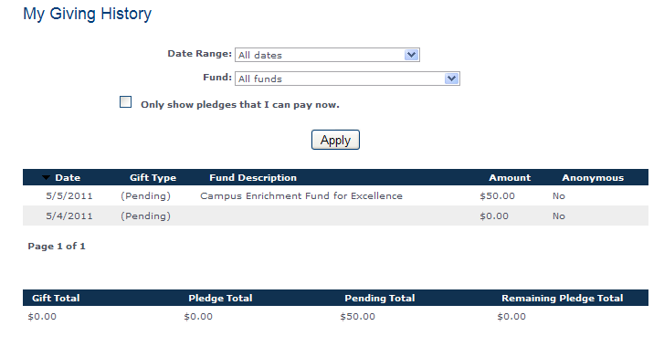
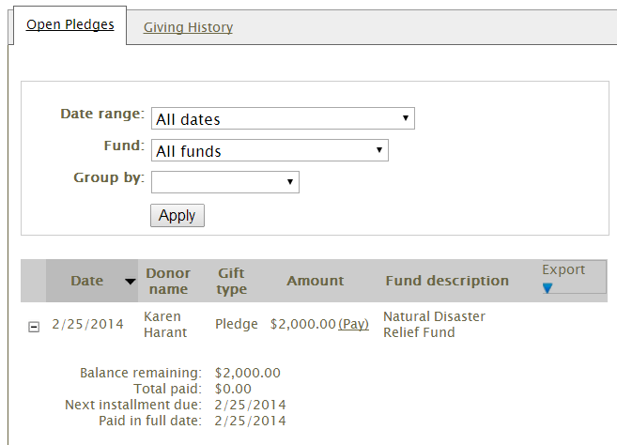
Transaction Manager - Giving History
The Transaction Manager provides the donor with a list of their giving history. You have the option to control what information is available to them by filtering on gift types, campaigns, funds and appeals.
If the donor has an outstanding pledge, you can also make a donation form available to them so a payment can be made on the pledge.

Slide 34
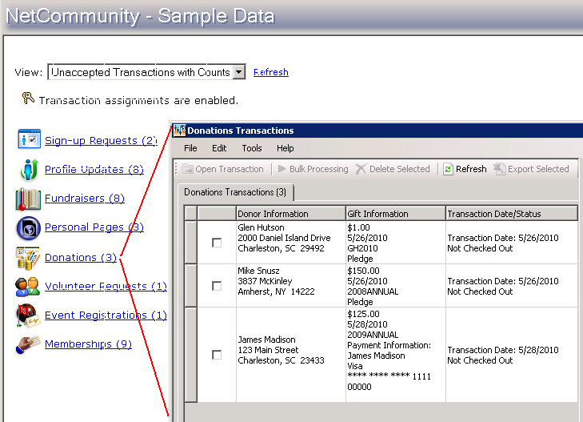
NetCommunity Plug-In
1. ) Create a batch in The Raiser’s Edge or remember the number of an existing uncommitted Batch in The Raiser’s Edge where the Blackbaud NetCommunity gifts should go. This will usually mimic the first step in offline gift processing.
2. ) The required NetCommunity Grow fields link to the batch automatically. For example, the various NetCommunity Grow gift attributes will automatically add to any batch selected.
3. ) Open the Blackbaud NetCommunity page in The Raiser’s Edge.
Select Donations.

Slide 35
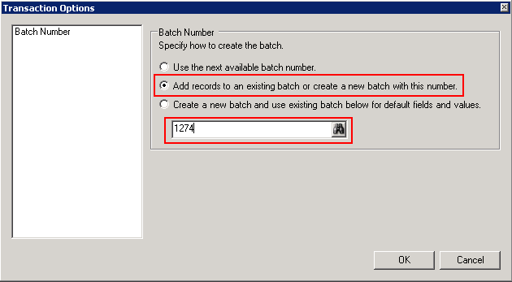
NetCommunity Plug-In
4. ) On the menu bar, select Tools>Transactions Options.
5. ) Select “Add Records to an existing batch or create a new batch with this number” and enter an existing batch number (or click the binoculars icon to search for an existing, uncommitted batch). Click OK. All transactions for this processing session will now default into this selected batch.
Note - If you exit the Transaction interface at any time and return to process transactions, you will need to select the Batch again (steps 4 and 5).
Note - Choosing the other two options is not recommended. While they both are able to create a Batch automatically, they both require that you go through the steps 4 and 5 after processing the first transaction or you will keep creating new batches, each with one gift in them. In other words, the new Batch that is automatically created will not become the default Batch for the second and subsequent transactions. Choosing “Add records to an Existing Batch…” limits the risk and simplifies the process.

Slide 36
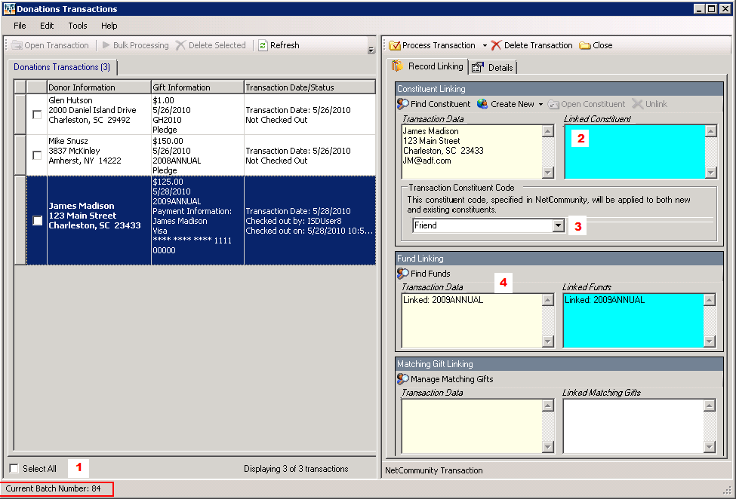
NetCommunity Plug-In
6.) Select a specific donation transaction by clicking on it. Press F7 to search for the constituent in The Raiser’s Edge. Match the donation to a new or existing constituent record.
Note - The checkboxes are only used for identifying transactions to be bulk processed or exported, so they are not used in standard processing.
Note 1 - The Batch number appears at the bottom-left of the window. This indicates where processed gifts will currently go.
Note 2 - The Linked Constituent information displays if either the constituent is auto-matched or if the constituent was logged into Blackbaud NetCommunity when they made the transaction. Auto-matching criteria can be found under Tools>Global Options.
Note 3 - You have the ability to assign a default on a constituent code on the donation form (and event and membership forms). Keep in mind that it applies the code to both new and existing Constituent records, so its use is somewhat limited considering standard use of The Raiser’s Edge constituent codes.
Note 4 - The Fund will auto-link based on the designation chosen by the donor or the default for the donation form.

Slide 37
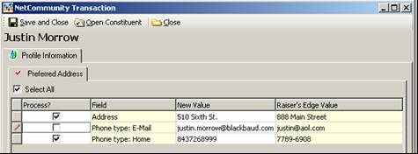
NetCommunity Plug-In
7. ) Update the constituent’s information as needed and click Save and Close.
8.) If you chose not to process information in specific fields as shown in step 7, then select “Yes” when prompted to reject any remaining updates.

Slide 38
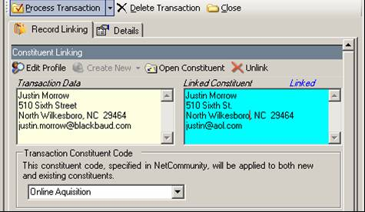
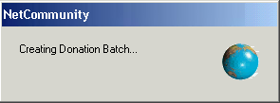
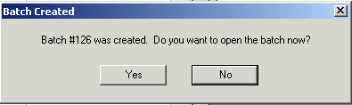
NetCommunity Plug-In
9.) Select “Process Transaction” to add this donation to the Batch.
Note - Users will be prompted to match any outstanding transaction information such as: Tribute, if it is Tribute Gift
Fund, if the online form allows the donor to type in a designation Organization, if the giving on behalf of a company option is offered on the form and selected by the donor Matching Gift, if the option is offered on the form and selected by the donor.
10.) Upon completion, the spinning globe appears with the message that a new Batch is being created, even when the transaction is being placed in an existing Batch. Ignore the message and know that a new Batch is not being created for each transaction, assuming you have followed these instructions.
The last message appears stating that the Batch was created (even if the processed transaction was placed into an existing Batch). It also offers to open the Batch. Select “No,” unless you have completed the transactions or want to check the Batch for some reason.
11.) Repeat steps 6-10 until all transactions have been processed.

Slide 39
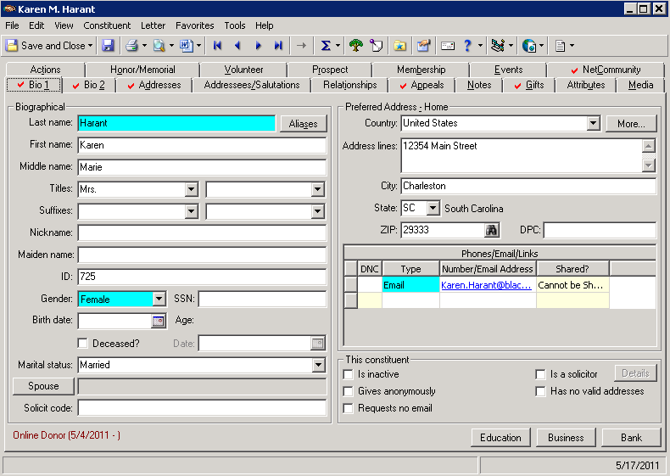
Appendix – NetCommunity tab in re
Constituents with records linked to BBNC will have a NetCommunity tab with a red check. It is in the top row of tabs on the right end.

Slide 40
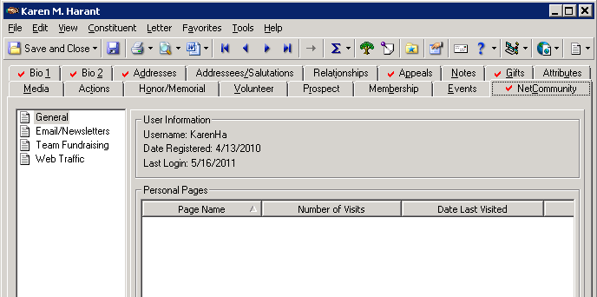
Appendix – General Category
Within the tab, there are four categories with information: General, Email/Newsletters, Team Fundraising and Web Traffic. Grow does not include Team Fundraising so this tab will not be populated.
The General tab will have the basic NetCommunity Username, Registration and Last Login Date.

Slide 41
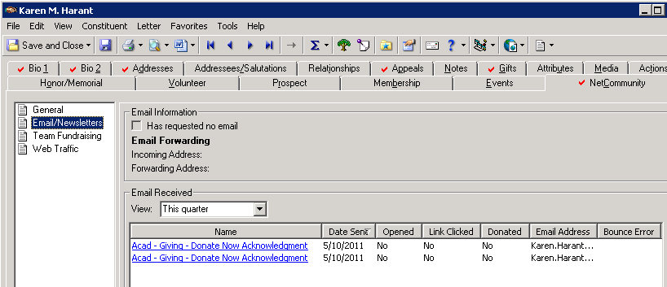
Appendix – Email/Newsletter Category
The Email/Newsletter section contains information from NetCommunity emails that feeds into RE. This includes opting out of emails and emails sent/received.
Note - When the Has requested no email checkbox is marked, the Requests no email checkbox on the Bio 1 tab is automatically marked. Similarly, if, on the Bio 1 tab, you unmark Requests no email, the Has requested no email checkbox is automatically unmarked.
Note - If the constituent receives a message but does not display its images or click a link in the email, the email is not considered as opened.

Slide 42
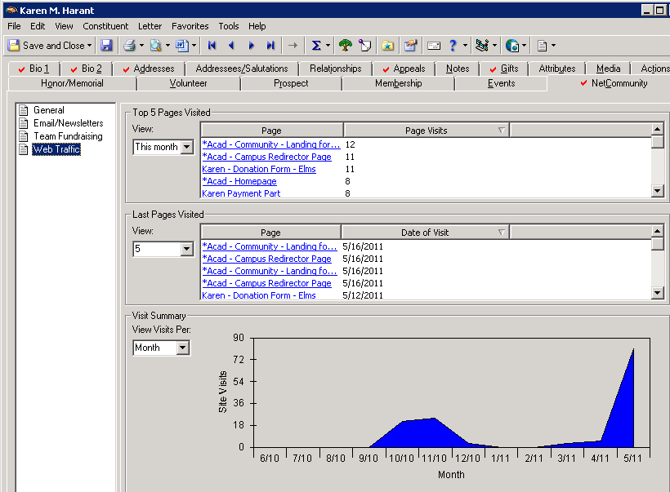
Appendix – Web Traffic Category
In Web Traffic category you will find information about the constituent’s browsing activity on your NetCommunity website, including the pages most frequently and most recently accessed.

